Slide 1
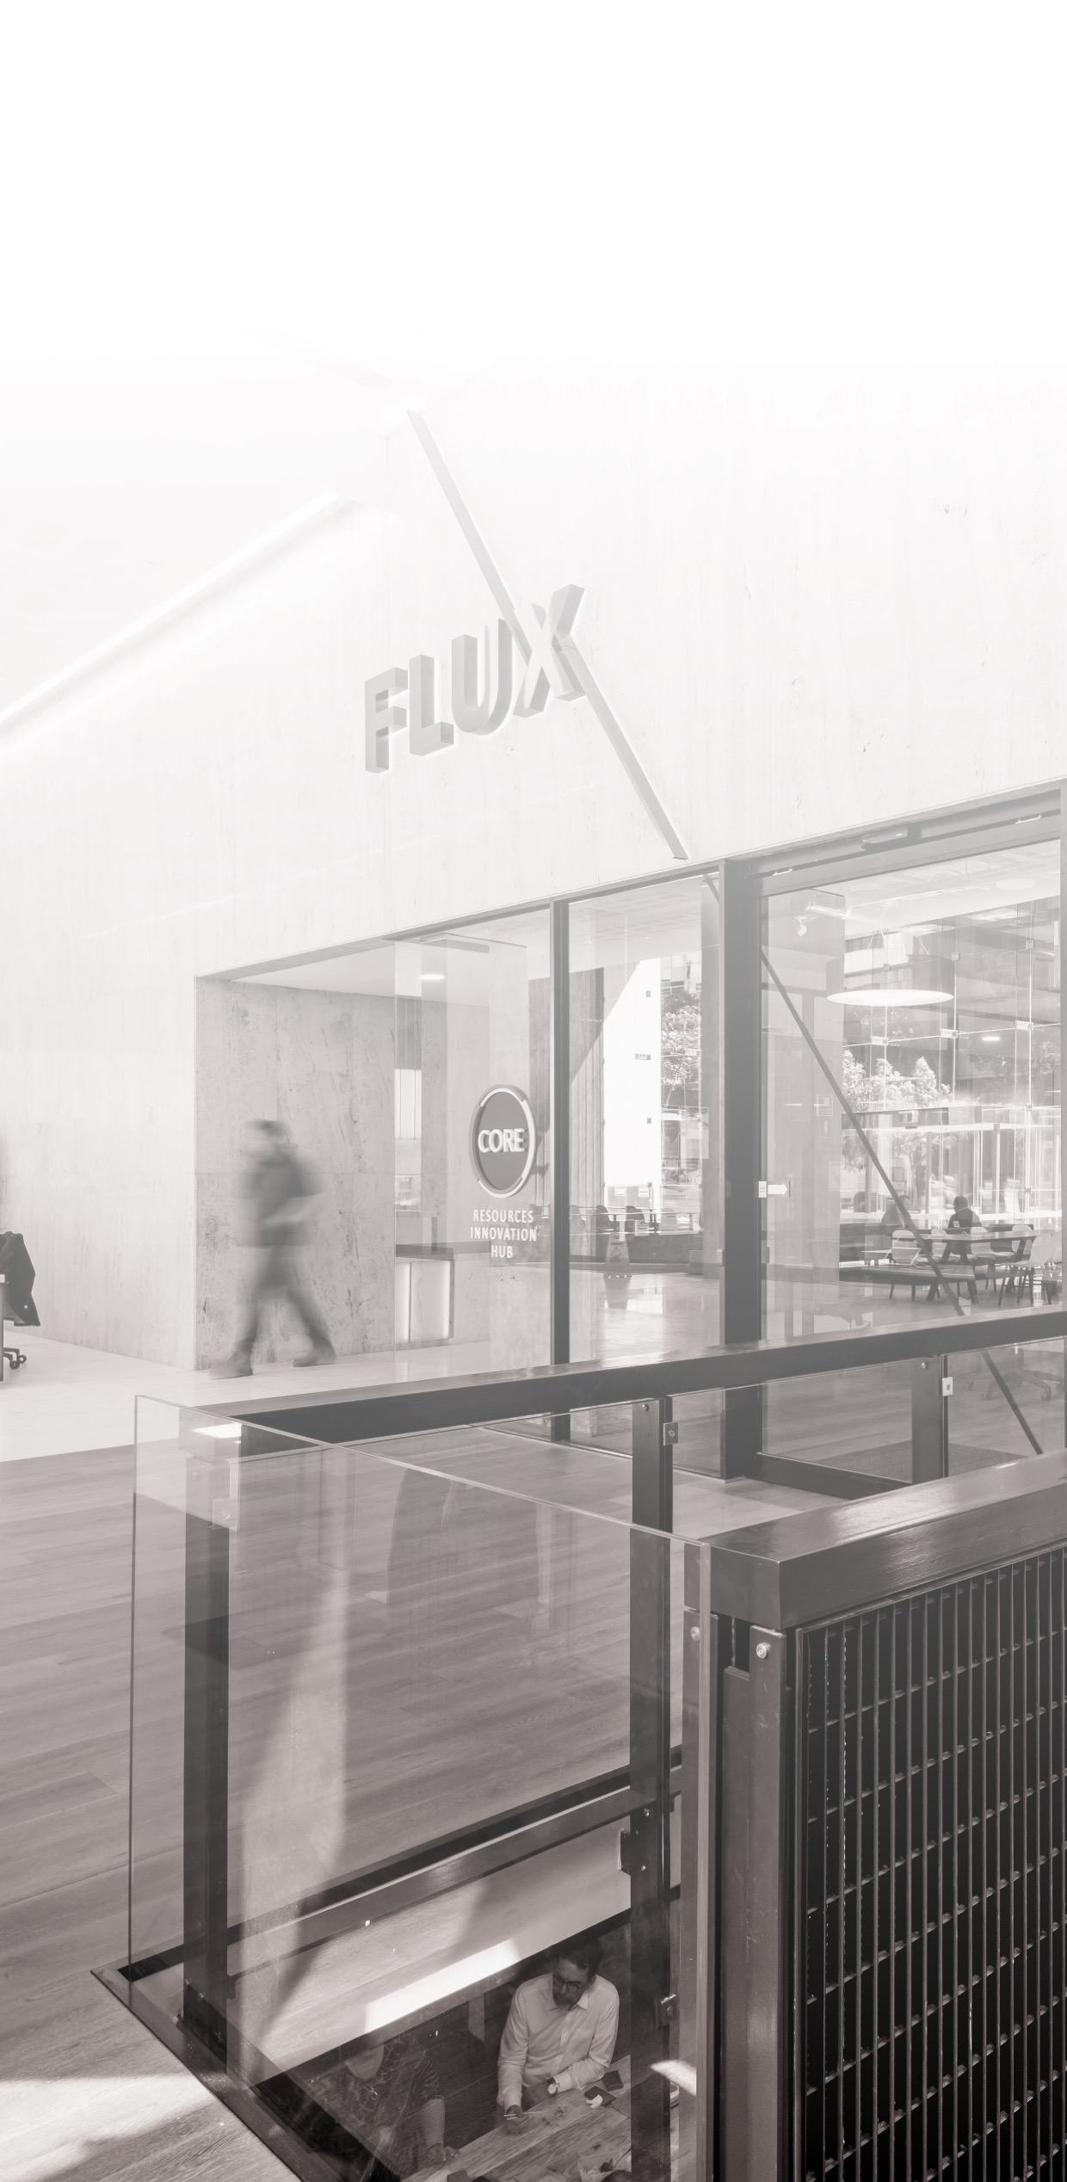


^{An Introduction} ^{to Clustering}
^{Oscar Rondon}
^{October 2018}

Slide 2
The aim of clustering is to group a set of observations
Observations in the same cluster should be more similar to each other that observations in other clusters
Observations usually correspond to high dimensional data and therefore manual definition of groups or clusters is not an easy task
There are many applications of clustering in practice
Petroleum
Mining
Medicine
Medical Imaging
Banking
Internet

Slide 3
There are a substantial number of techniques developed to group data into clusters
The simplest one is called K-means clustering
K refers to the number of clusters one wants to identify
It should be specified in advance but there are newer approaches where this is not required
K points called centroids are randomly initialised and iteratively move to the center of each cluster
The process is stopped when there are no further changes in the centroid values

Slide 4
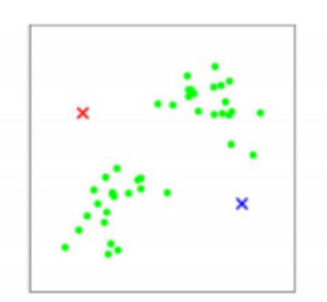
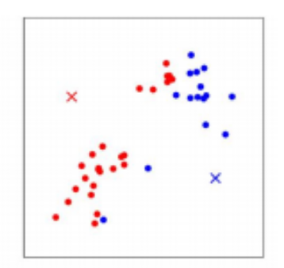
Dataset with two clusters. Centroids are randomly initialised
Centroid 1
Centroid 2
Cluster 1 is assigned to the closest data points to centroid 1
Cluster 2 is assigned to the closest data points to centroid 2
Centroid 1
Centroid 2

Slide 5
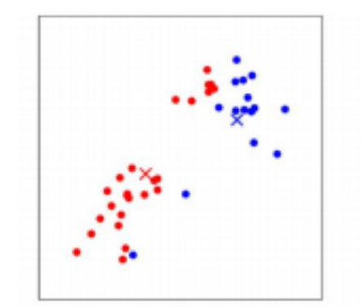
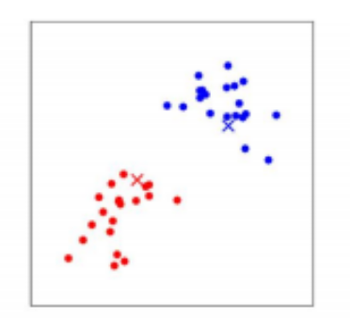
Calculate the centroid of points in cluster 1 and cluster 2
Move centroid 1 and centroid 2 to these locations
Cluster 1 is assigned to the closest data points to centroid 1
Cluster 2 is assigned to the closest data points to centroid 2

Slide 6
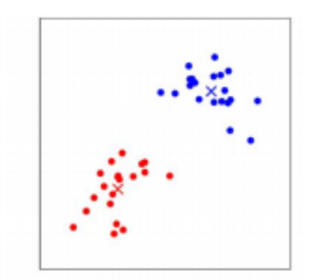
Repeat until there are no more changes in the centroid locations
Centroid 2
Centroid 1
The centroids obtained are representative of the cluster of points and are used for further analysis

Slide 7
^{Hierarchical clustering}
^{Oscar Rondon}
^{October 2018}

Slide 8
Hierarchical clustering works using a measure of similarity between observations
The choice of the similarity measure depends on the problem
Data values start all in one cluster and splits are carried out recursively using different linkage criteria
The process is represented using a dendogram
The clusters are determined visually by analising the dendogram and using expert judment

Slide 9
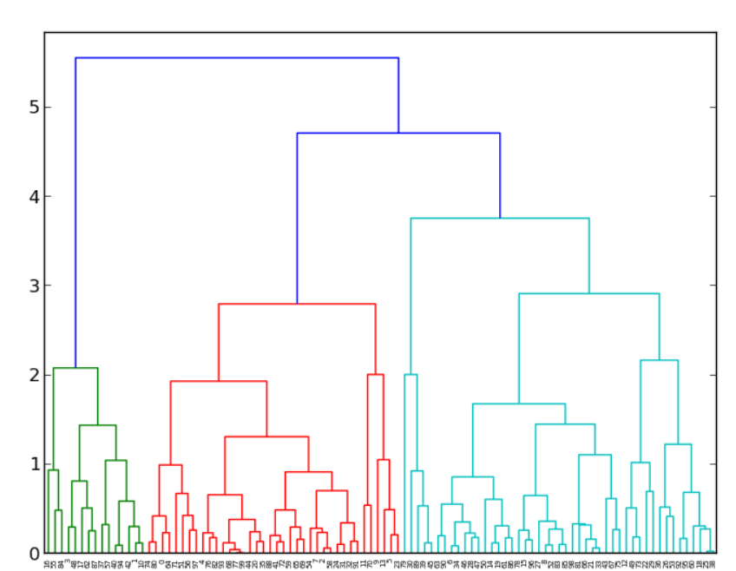
Example of a dendogram showing three clusters

Slide 10
^{Spectral Clustering}
^{Oscar Rondon}
^{October 2018}

Slide 11
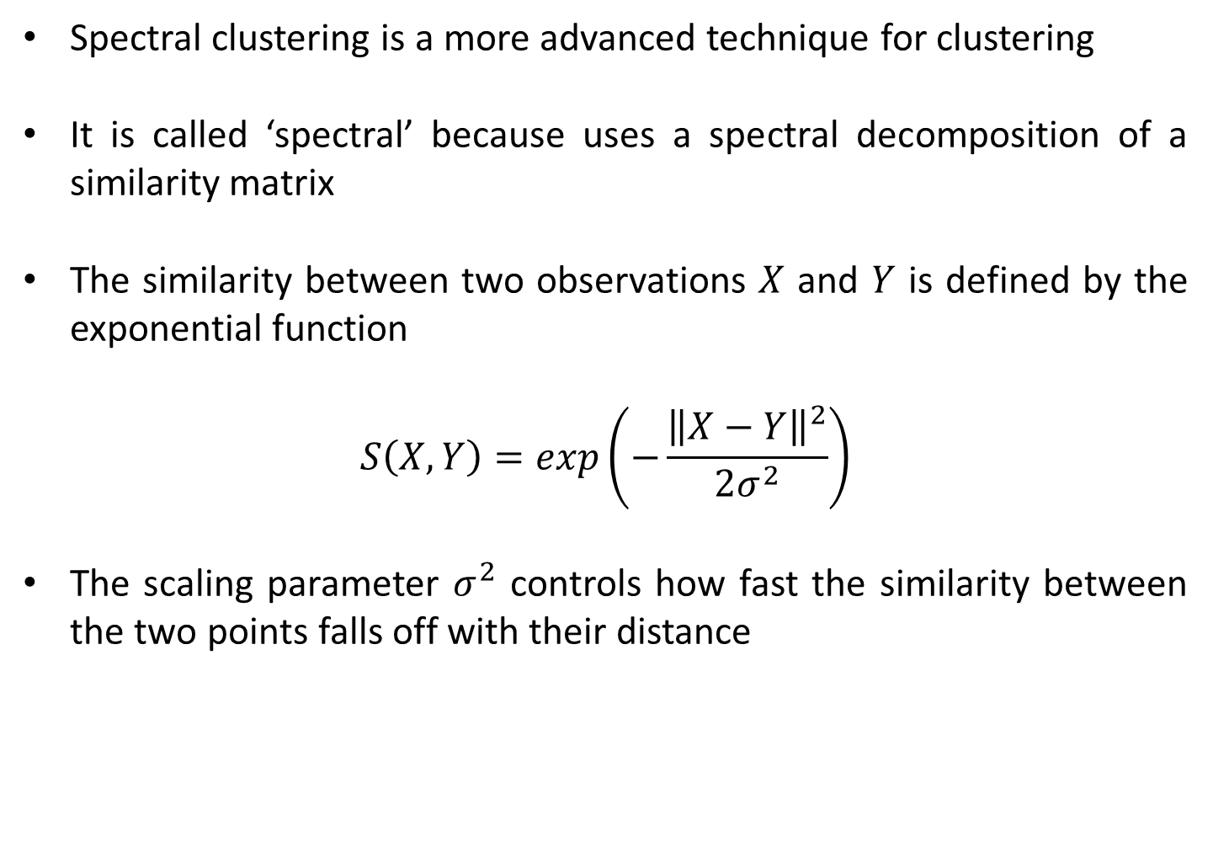
Spectral clustering is a more advanced technique for clustering
It is called ‘spectral’ because uses a spectral decomposition of a similarity matrix
The similarity between two observations $X$ and $Y$ is defined by the exponential function
$$S\left(X,Y\right)=exp\left(−\frac{{\left\|X−Y\right\|}^{2}}{2σ^{2}}\right)$$
The scaling parameter $σ^{2}$ controls how fast the similarity between the two points falls off with their distance

Slide 12
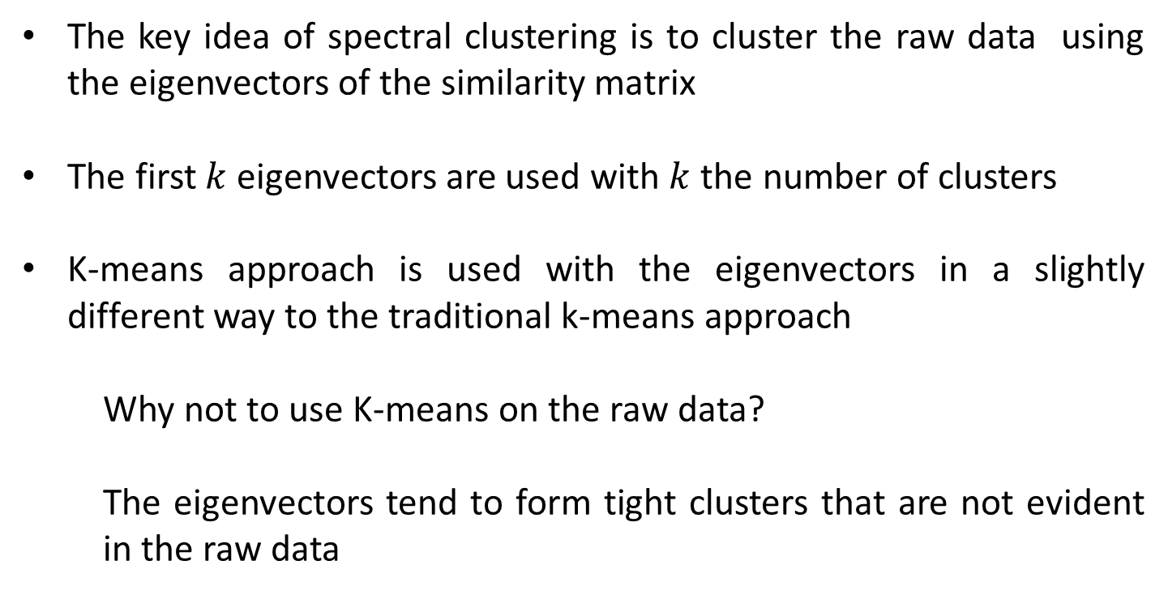
The key idea of spectral clustering is to cluster the raw data using the eigenvectors of the similarity matrix
The first $k$ eigenvectors are used with $k$ the number of clusters
K-means approach is used with the eigenvectors in a slightly different way to the traditional k-means approach
Why not to use K-means on the raw data?
The eigenvectors tend to form tight clusters that are not evident in the raw data

Slide 13
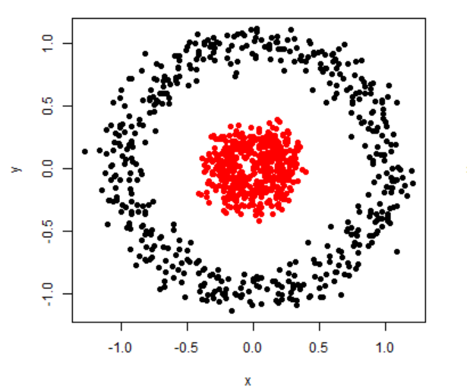
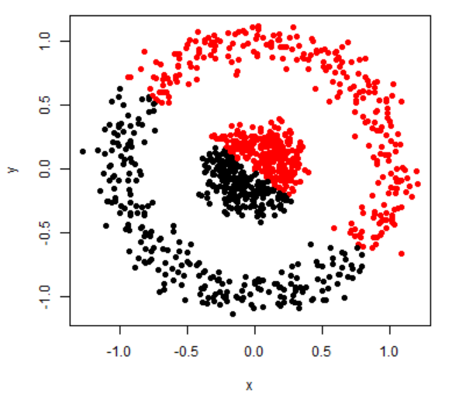
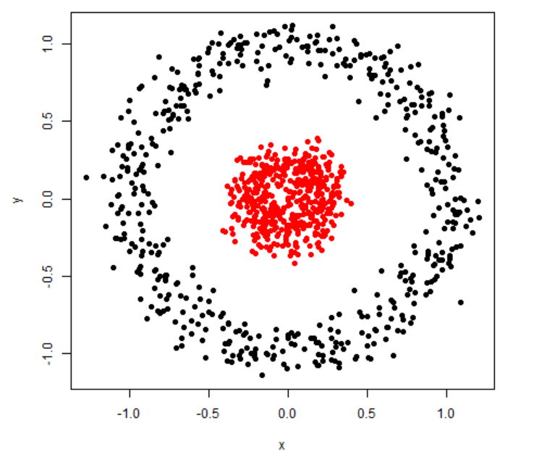
Raw data
K-means clustering
Spectral clustering

